Slide 1
Faith Formation 2020-2021
A family of Believers: Called and Sent by JEsus

Slide 2
Welcome!

Slide 3
Conversation Partners
Tom Quinlan, Ministry Director, St. Joseph Educational Center
Fr. Tim Fitzgerald, Pastor, Ss. John and Paul Parish
Paulette Chapman, Director of Adult Faith Formation, Ss. John and Paul Parish
Jenni Lihs, Coordinator of Faith Formation, Ss. John and Paul Parish

Slide 4
Opening prayer
The Surrender Novena
Oh Jesus, I surrender myself to you. Take care of everything.

Slide 5
overview
How did we get to this place?

Slide 6
A moment of opportunity
The call for “lifelong growth in faith”
Guide and support parents as primary mentors in faith
Pandemic crisis that provides an opportunity
Growth in faith for all Catholics
Faith Formation for all members of the community, lifelong growth in faith
Adult growth in faith “to be considered above all else”
Parents as primary catechists for their children

Slide 7
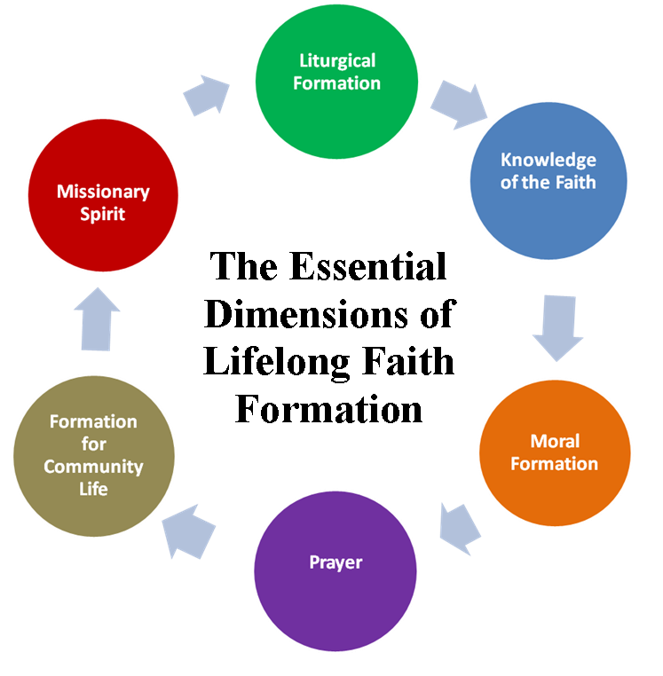
Family/Intergenerational Catechesis
17 years at SSJP
Adapted Generations of Faith model
Lifelong formation in faith is the guiding principle
Uses the language of “household”
Rooted in Scripture and the Catechism of the Catholic Church
Incorporates the Six Tasks of Catechesis

Slide 8
Lifelong Formation in Faith begins in the home
The family … “is called to be a ‘domestic church,’ a place of faith, of prayer and of loving concern for the true and enduring good of each of its members.” Pope Benedict (Homily in Nazareth, 5.14.09)
“Love is shown by little things, by attention to small daily signs which make us feel at home. Faith grows when it is lived and shaped by love. That is why our families, our homes, are true domestic churches. They are the right place for faith to become life, and life to grow in faith.” Pope Francis (World Meeting of Families Homily, 9.27.15)
“We are entering a period of new vitality for the Church, a period in which adult Catholic laity will play a pivotal leadership role in fulfilling the Christian mission of evangelizing and transforming society. For adults to fulfill their role in this new era of the Church, their faith formation must be lifelong, just as they must continue to learn to keep up in the changing world.” Our Hearts Were Burning Within Us: A Pastoral Plan for Adult Faith Formation in the United States, 29

Slide 9
IN one mom’s words
Jo Ellen's "Why we like Faith Formation"

Slide 10
September preview
Mike Patin Video

Slide 11
Questions?
Any broad conceptual questions before we dive into the particulars?

Slide 12
a Sample month in our parish
Week One – Sunday and Wednesday – Faith Formation L!VE (recorded for those who can’t join live)
Week Two – Monday – Check-in text encouraging households to interact with Kitchen Table Faith
Week Three – Monday – Check-in text reminding households to complete this month’s Parish Connection
Wednesday – Adult Faith Formation L!VE
Week Four – Thursday -- Next month’s invitation to live session goes out with instructions to prepare

Slide 13
Setting the Context
Fr. Tim's Setting the Context

Slide 14
Kitchen table Faith

Slide 15
Where do I Learn more about intergenerational Faith formation, playlists, etc.?
Resources that have been helpful for us:
vibrantfaith.org offers master classes (including one on playlists) and coaching, as well as Catalyst – on online network for sharing and resourcing for lifelong growth in faith
cmdnet.org (Center for Ministry Development) offers training and resources for lifelong faith formation

Slide 16
Where do we find it all?
Go to virtualfamilyofbelievers.weebly.com to access these resources
To see how we have organized our playlist, visit our parish website: www.ssjohnpaul.org, and click on the Kitchen Table Faith button on the front page

Slide 17
Our Guiding principle
“Catechesis for adults … must be considered the chief form of catechesis. All other forms, which are indeed always necessary, are in some way oriented to it.” (GDC, #59)
“WE (Bishops) call the Church in our country to a renewed commitment to adlt faith formation, positioning it at the heart of our catechetical vision and practice…without weakening our commitment to other essential educational ministries…” (OHWB, #6)

Slide 18
Questions and Answers

Slide 19
Come, Holy Spirit!

