Slide 1
A Family of Believers: Called and Sent by Jesus
Thanks be to God

Slide 2
Let’s touch base as we begin…
Note: We plan to display this slide 15 minutes before the scheduled start of the gathering.
Using the chat, please tell us your family name and the most unusual place you have shared a meal together.
Please remember to have your candle and Bible, handout (or a piece of paper), and something to write with ready when we begin!

Slide 3
Opening sketch and music
We asked four households to make short videos showing themselves getting ready for Faith Formation. We then put them together to make one video, about three minutes in length. We play it twice beginning six minutes before the gathering begins.
Note: John Roberto urges parishes to think in “seasons” of about three months this year. We decided to use the same video for September, October, and November and hope to change it up in December
After the video, we have a little music and a slide to signal that it’s time to begin.

Slide 4
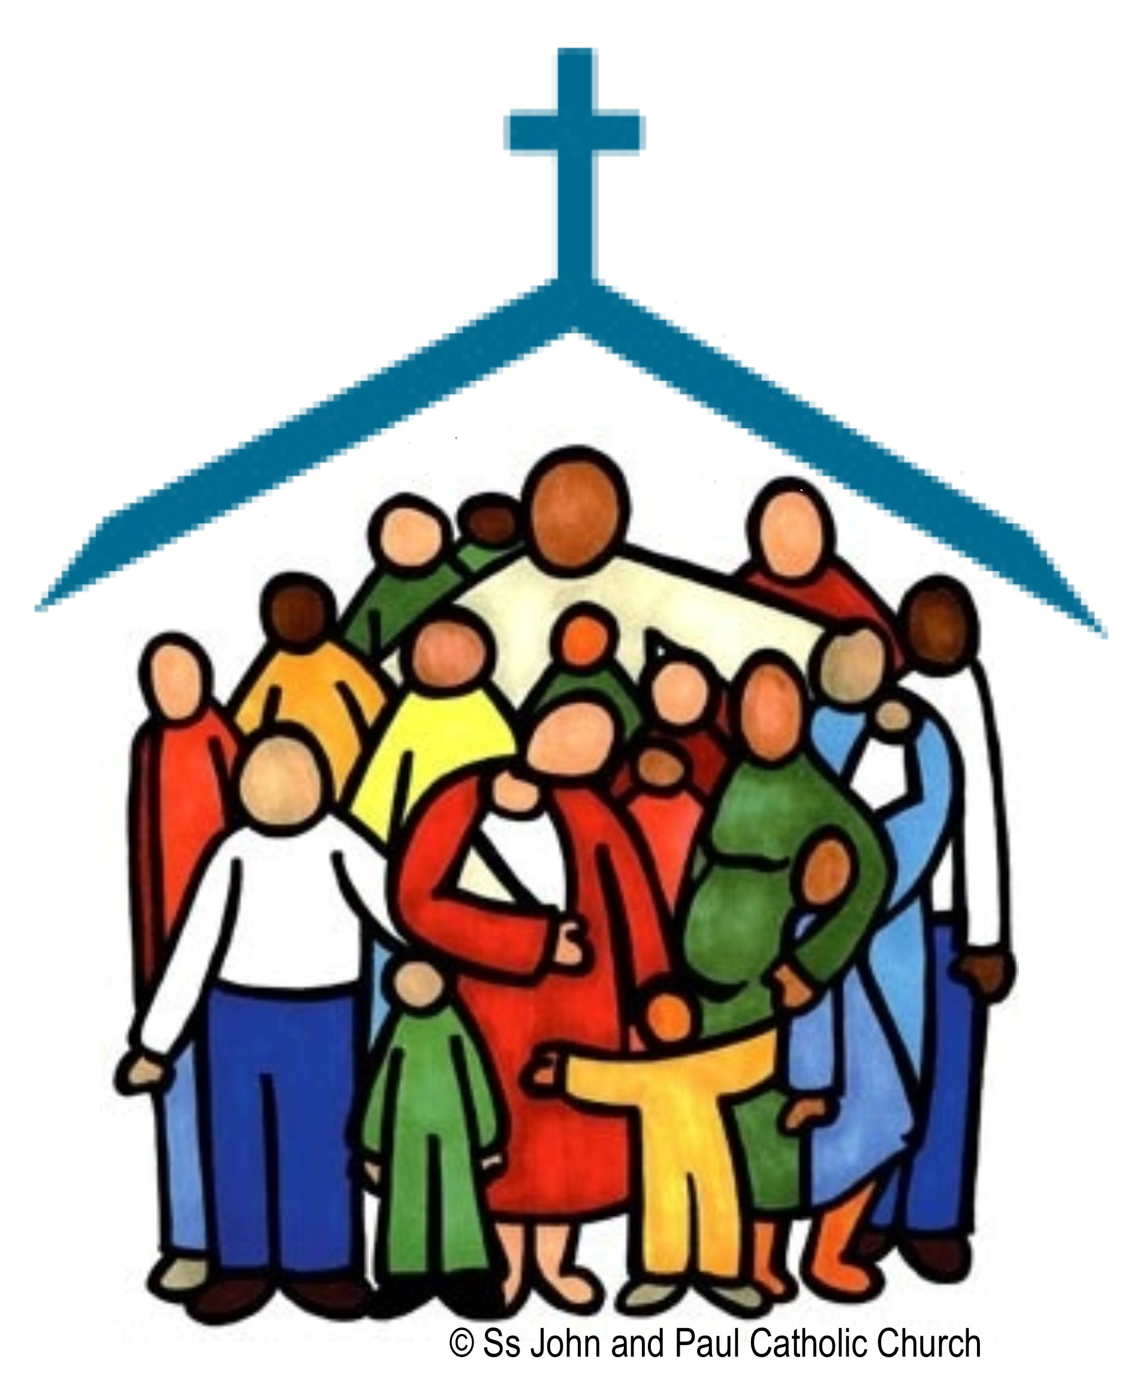
Welcome!

Slide 5
When on Zoom….
Please keep your cameras on, if possible. We want to see you!
Please keep your mic muted unless invited to unmute.
Please use the chat function to ask questions or comment.
We suggest you use speaker view, so you can clearly see who is speaking when a team member is on live.

Slide 6
What’s Happening at the Parish?
Last month, the Parish Connection was to write a phrase or sentence or two that St. Paul would say to us if he were writing a letter to our parish. We will edit those contributions together to write a letter to our faith community. We plan to read that letter here, while showing a slide show of photos of parish life.

Slide 7
Setting the Context
Fr. Tim or a member of the team previews the topic of our gathering and shares how it fits into the focus for the whole year.

Slide 8
Take 5
Do you have a family meal tradition?
Are there cultural influences at your family gatherings?
Who are the ancestors you remember and talk about?
(See the opening activity in the script for an explanation of this)

Slide 9
Call to Prayer
We took a short video of one of our families preparing their prayer space and then beginning prayer together. It is available in the videos section of the Virtual Family of Believers website, or you can have one of your families make a video.
John Roberto urges parishes to think in “seasons” of about three months this year. We decided to use the same video for September, October, and November and hope to change it up in December

Slide 10
Opening Prayer
Philippians 4:4-7
Take 5
Questions for household discussion:
What makes you glad?
What does it mean to be gentle with people?
How does praying help us when we are worried?
What does it mean to have a thankful heart?

Slide 11
Opening Prayer
Psalm 136
All: God’s love is everlasting!

Slide 12
St. Paul and the Early Church
We will have a parishioner play the character of St. Paul. He will use a set of questions, called “Paul’s Travel Trivia,” to explain more about his life and ministry.

Slide 13
St. Paul and the Early Church
For over 35 years I traveled from town to town, country to country to tell the Good News of Jesus Christ. I established new small Christian communities with guidelines and suggestions for how to learn about and worship Jesus and how to care for the poor. We shared meals and worked together.
What job do you think I did to earn a living?
Carpenter
Lawyer
Tent Maker
Look up Acts 18:3 for the correct answer.

Slide 14
St. Paul and the Early Church
It’s hard to travel through unknown areas and it can be dangerous. Who was my travel companion during my early years?
Peter
Barnabas
Nathaniel
Look up Acts 13:2 for the correct answer.

Slide 15
St. Paul and the Early Church
I would spend a few years in some areas. We would gather on the Lord’s Day, remember the words of Jesus, sing, pray, and share a meal. We spoke of the gifts that God gives each of us. The greatest of gifts are faith, love, and:
Hope
Teaching
Preaching
I Corinthians 13:13 will give you the answer.

Slide 16
St. Paul and the Early Church
When Silas and I were in Philippi, we were arrested for preaching about Jesus. While in prison a most amazing thing happened. Although we were in chains, we sang and praised God all evening. At midnight, an earthquake that open the prison doors and shook the chains right off. When the jailer saw this, he tried to kill himself because he knew the leaders would blame him. Paul called out to him to show they were still there.
What happened next?
The jailer put new chains on Paul and Silas
The jailer asked what he must do to be saved
The jailer ran away before his superiors arrived
Turn to Acts 16: 34

Slide 17
St. Paul and the Early Church
I traveled through many lands by walking. But in my last days, I traveled by ship. I had been arrested in Jerusalem, but because I am a Roman citizen, my trial is to be in Rome. On the way to Rome, our ship wrecked. We were able to swim to the nearest island. What island did we swim to?
Crete
Sicily
Malta
Turn to Acts 28:1

Slide 18
Give Thanks
A member of the team will talk here about the “giving thanks” language so prevalent in Paul’s letters, and will tie it to the giving thanks portion of the Jewish meal ritual, which was drawn into Christianity, and is part of our ritual today.
We will invite participants to look up a couple of passages from Paul’s letters.
We will end by asking them to reflect on what they give thanks for, even in these tough times. We will create a word cloud, or wordle from their responses.

Slide 19
Parish Connection
Food carries our stories and traditions
Share a special family recipe, such as:
oldest recipe in the family
something that is made every Thanksgiving, Christmas, birthday, etc.
a recipe that reflects your family’s cultural heritage or roots
a recipe that may have an association with a special person in your family tree
or a recipe that is special for another reason.
Use the link to the Google form to share your recipe and a short explanation of why it is important to your family. We will create a cookbook!

Slide 20
Kitchen Table Faith
We will explain the website for families who are new this month, remind households to engage with the website, and highlight some areas for them.

Slide 21
Announcements

Slide 22
Closing Prayer
God of the living, in whose image we have been formed, open our minds and hearts to Jesus your Son.
May our households be built on a foundation of faith and our lives be shaped by your living Word.
May our words and deeds announce your faithful love to all the world.
We ask this through Christ our Lord. Amen.
Leader: Go in the Peace of Christ.
All: Thanks be to God!
Note: We are using this as the closing prayer every month this year. We sent it in prayer card form to the families before the first gathering, in case they wanted to print it out. We will always have it on a slide for them as well.

Slide 23
Thank you!
Thank you for joining us for Faith Formation L!VE!
Join us next month for “Waiting in Joyful Hope”
Visit Kitchen Table Faith
Send in your Parish Connection

Slide 24
Check-in
After the official gatherings ends, we to stay on for a few minutes to let people unmute their mics and say “hello” to each other, etc.

